Slide 1



SQL Project
Yaduveer Singh “Business Analyst”
2024

Slide 2

SQL: Pizza Sales Analysis
“I am excited to share the completion of my recent SQL project focusing on pizza sales analysis. This project involved solving 13 questions that ranged from basic to advanced SQL queries. Through this project, I was able to demonstrate my skills in data extraction, manipulation, and analysis, providing valuable insights into the pizza sales data.
In this presentation, you'll find a comprehensive breakdown of the questions tackled, the SQL techniques applied, and the insights derived from the analysis”.

Slide 3
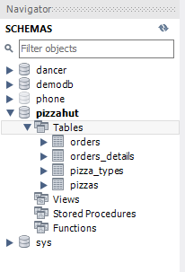
Schema

Slide 4
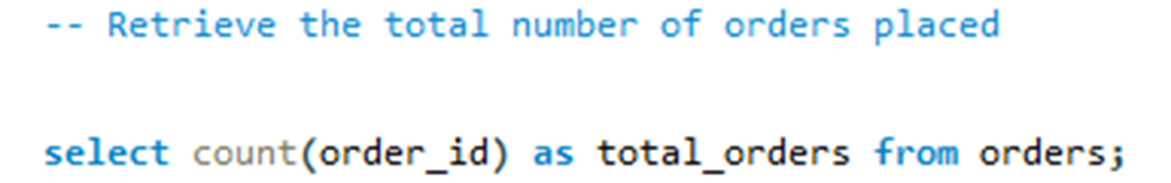
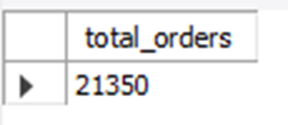
Retrieve the total number of orders placed

Slide 5
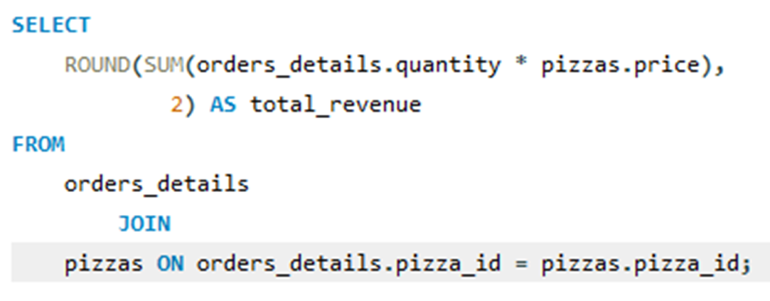
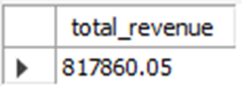
Calculate the total revenue generated from pizza sales

Slide 6
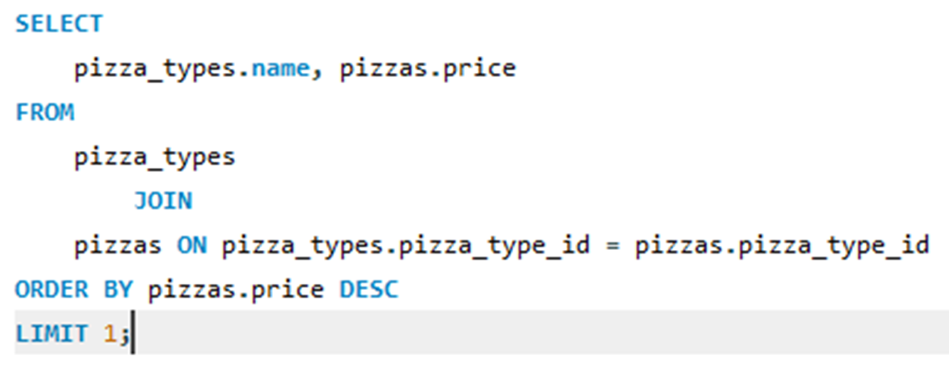
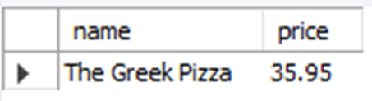
Identify the highest-priced pizza

Slide 7
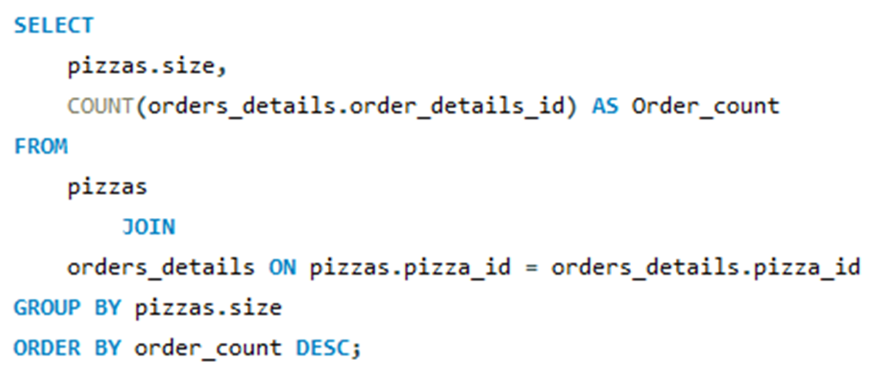
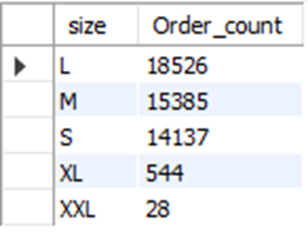
Identify the most common pizza size ordered

Slide 8
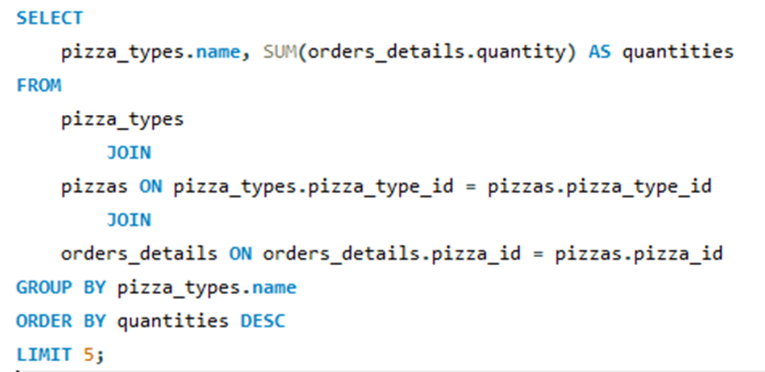
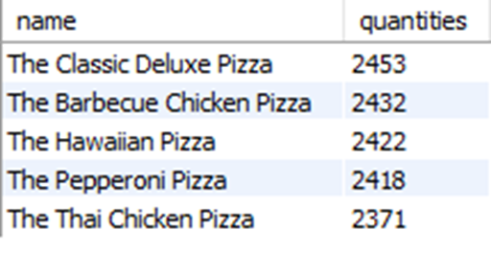
List the top 5 most ordered pizza types along with their quantities

Slide 9
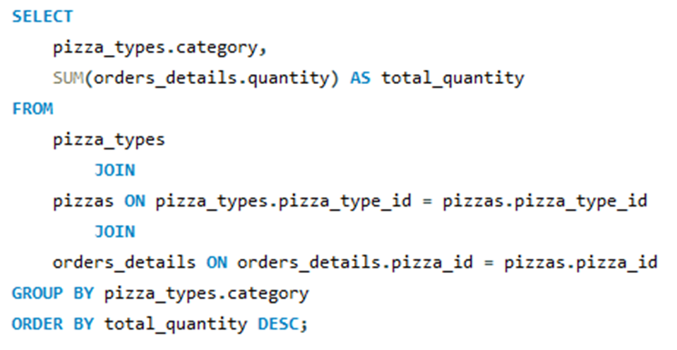
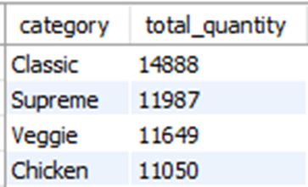
Join the necessary tables to find the total quantity of each pizza category ordered

Slide 10
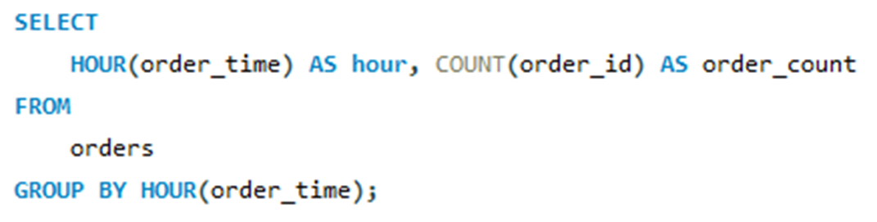
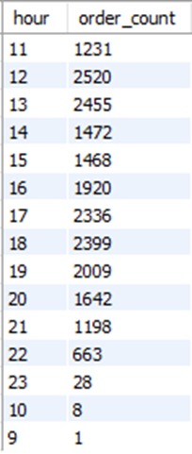
Determine the distribution of orders by hour of the day

Slide 11
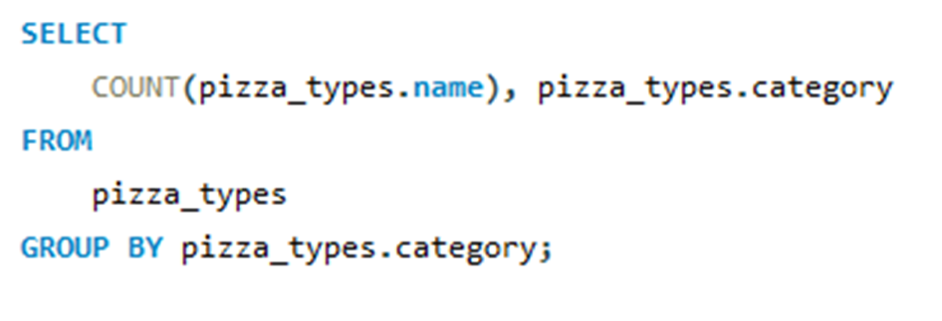
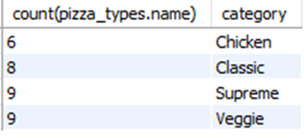
Join relevant tables to find the category-wise distribution of pizzas

Slide 12
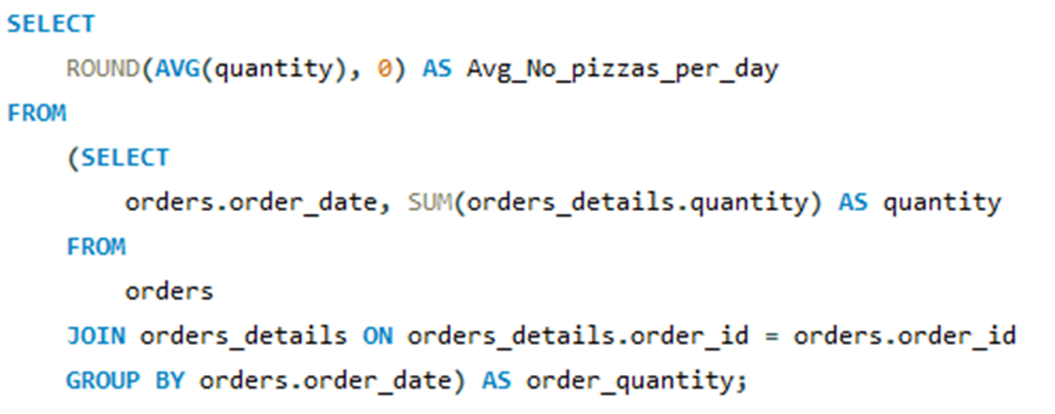
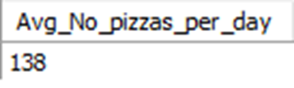
Group the orders by date and calculate the average number of pizzas ordered per day

Slide 13
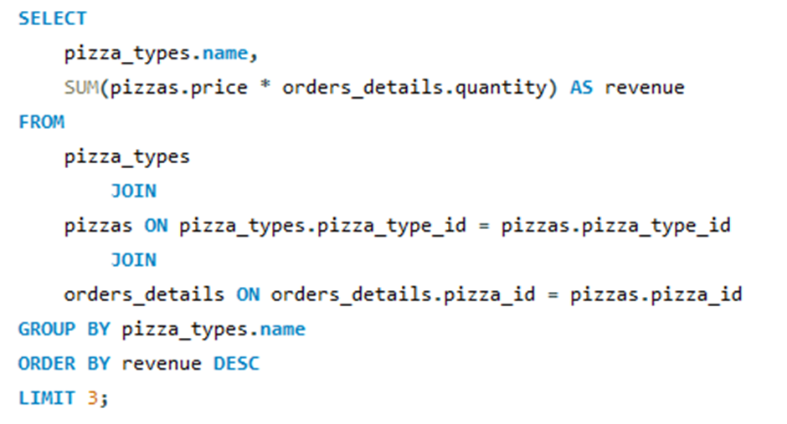
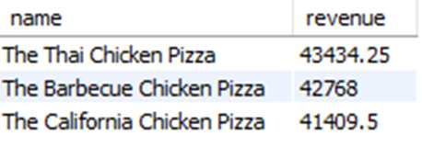
Determine the top 3 most ordered pizza types based on revenue.

Slide 14
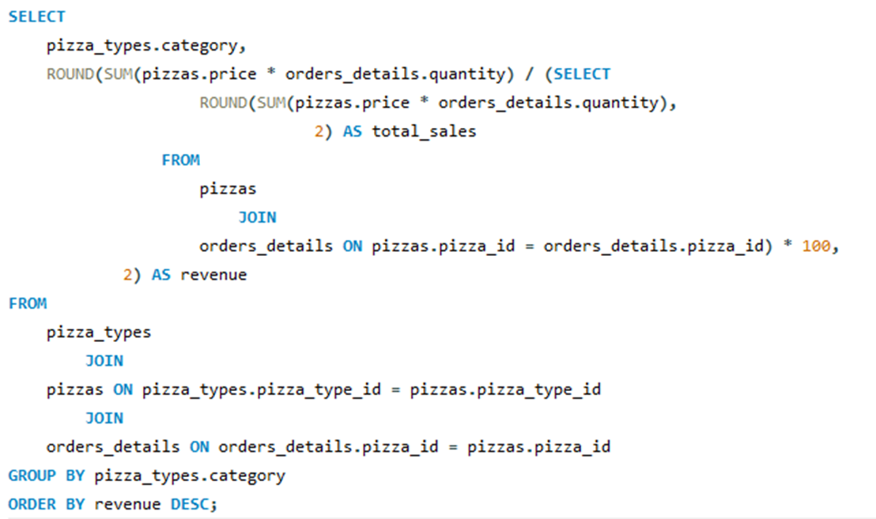
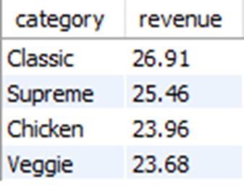
Calculate the percentage contribution of each pizza type to total revenue

Slide 15
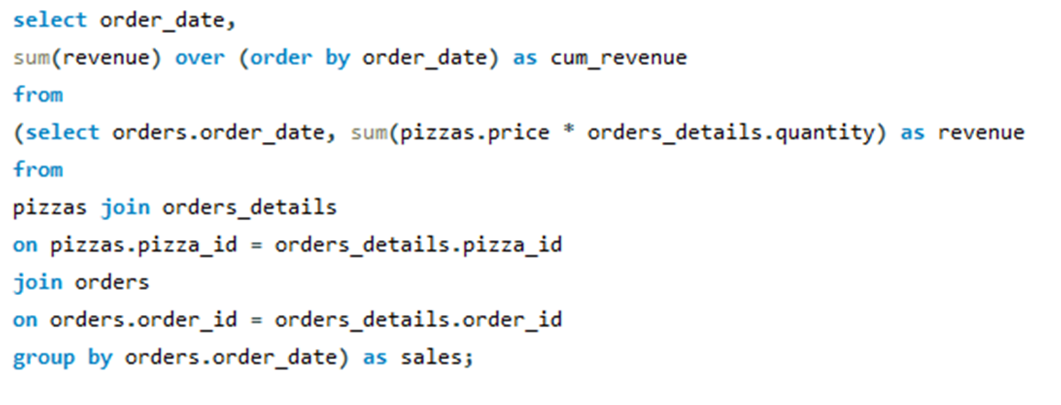
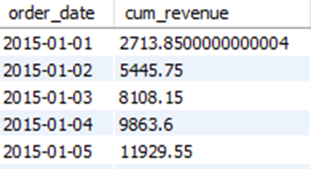
Analyze the cumulative revenue generated over time

Slide 16
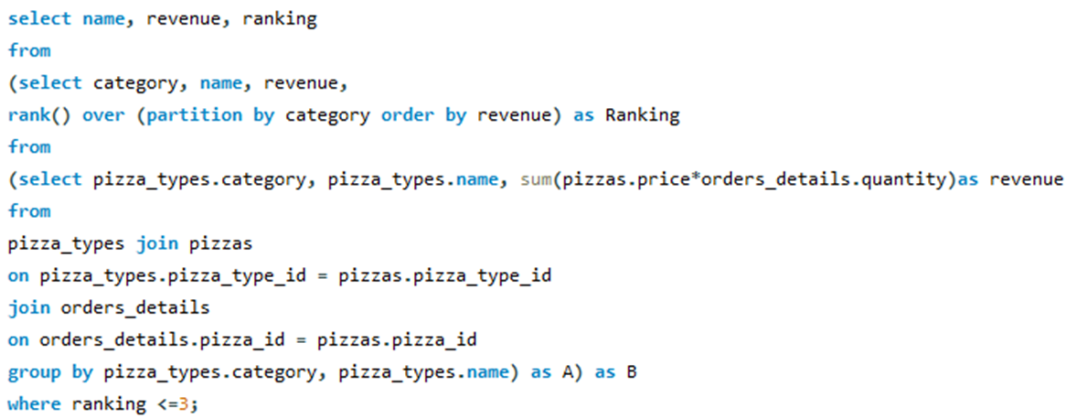
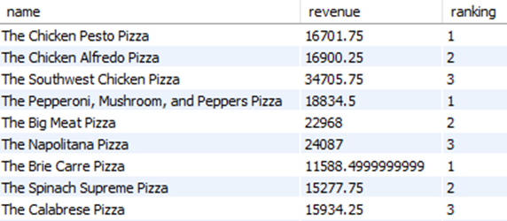
Determine the top 3 most ordered pizza types based on revenue for each pizza category

Slide 17




Contact
+91-9650344981
yaduveersingh23@gmail.com
www.linkedin.com/in/yaduveersingh23/

Slide 18
Thank you!
Yaduveer Singh
2024

